Slide 1
VOTING SYSTEM
WITH
BBM 443- Fundamentals of Blockchain

Slide 2
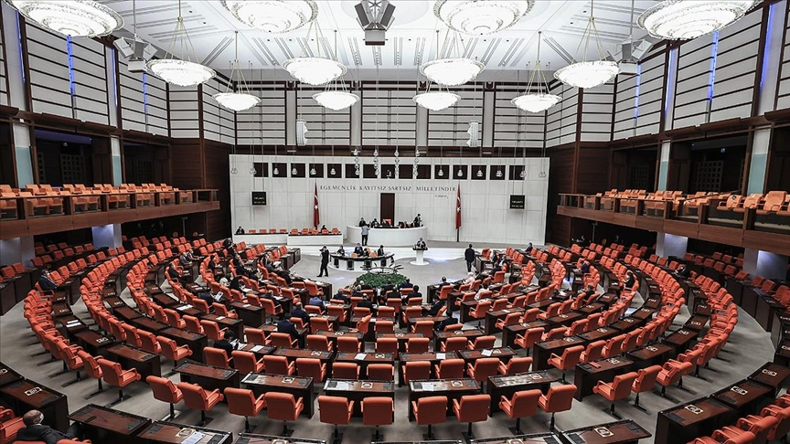
VOTING SYSTEM
2018
Humanity has used elections as a decision-making mechanism since they began to live as a community. Elections are very critical tools for the proper functioning of democracy. Through elections, citizens transfer their power to those who will represent them.

Slide 3
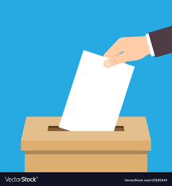
VOTING SYSTEM
Text Here
Text Here
Text Here
2019
2020
2021
Confidence among the electorate, the state, and the candidates during this power transfer is an indispensable value. The reliability of election systems play a key role in creating trust among the election stakeholders.

Slide 4
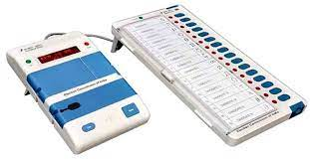
VOTING SYSTEM
Text Here
Text Here
2020
2021
Blockchain technology has come to a very important position today and with the development of this technology, its integration into many fields has increased. We believe that with this new technology, confidence will increase in the voting system. In addition, voting system technologies have developed and technological methods such as electronic voting machines and remote voting over the internet have developed.

Slide 5
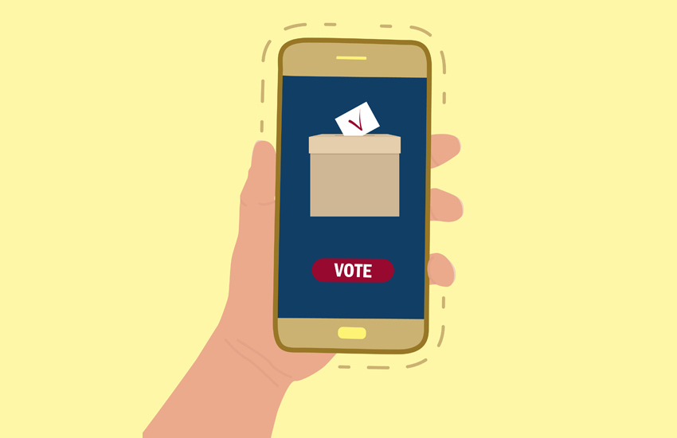
VOTING SYSTEM
The innovation with a blockchain is that it guarantees the fidelity and security of a record of data and generates trust without the need for a trusted third party. It is unthinkable that the election system technologies are not affected by this new technology. In this study, a model suitable for modern and democratic criteria is presented by utilizing the benefits of blockchain technology.

Slide 6

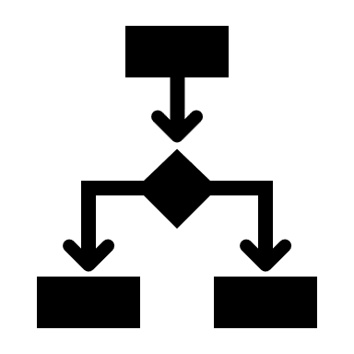


VOTING SYSTEM PROPOSED MODEL
01
SETUP
02
VOTING
03
COUNTING OF VOTES
04
ANNOUNCEMENT OF RESULTS
During the setup phase, regulators and voters set up the blockchain network and other systems that will be needed.
In the voting process, the voters choose to vote through client applications.
In the counting phase of the votes, the encrypted votes in the chain are transparently decrypted and counted.
After the counting process is completed, the results are announced.

Slide 7
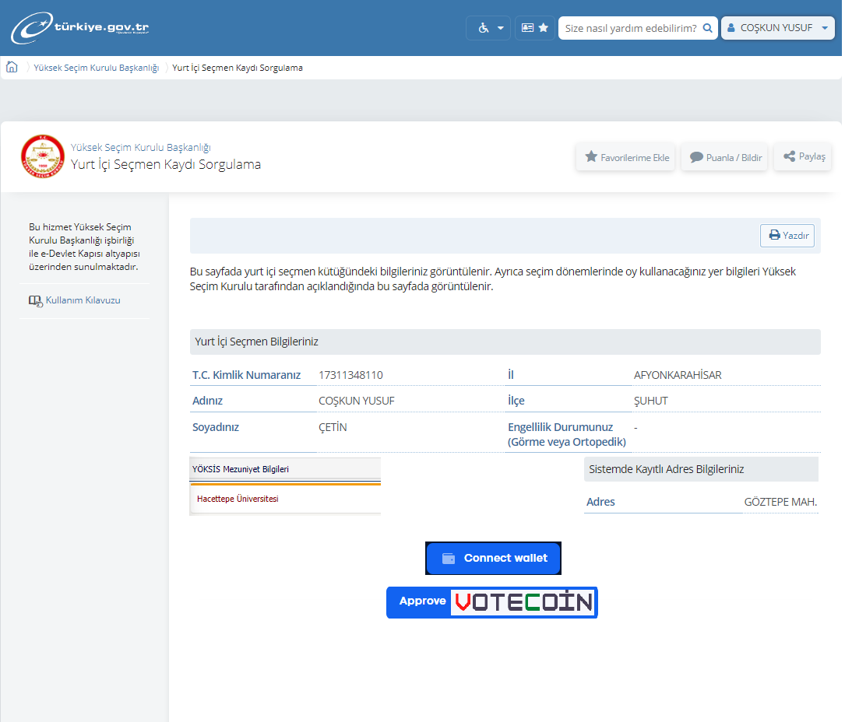
SETUP
The voter provides a wallet such as a metamask or trustwallet.
The voter connects his/her Wallet to the e-government system.
The voter approves the VoteCoins given to her/him.
The education level of the voter and the country they live in also affect the amount of VoteCoins they will receive.

Slide 8
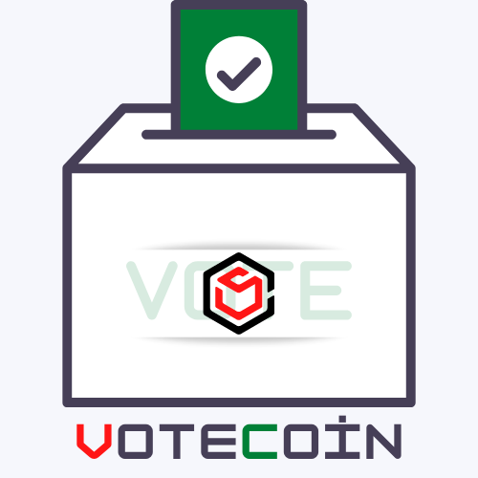
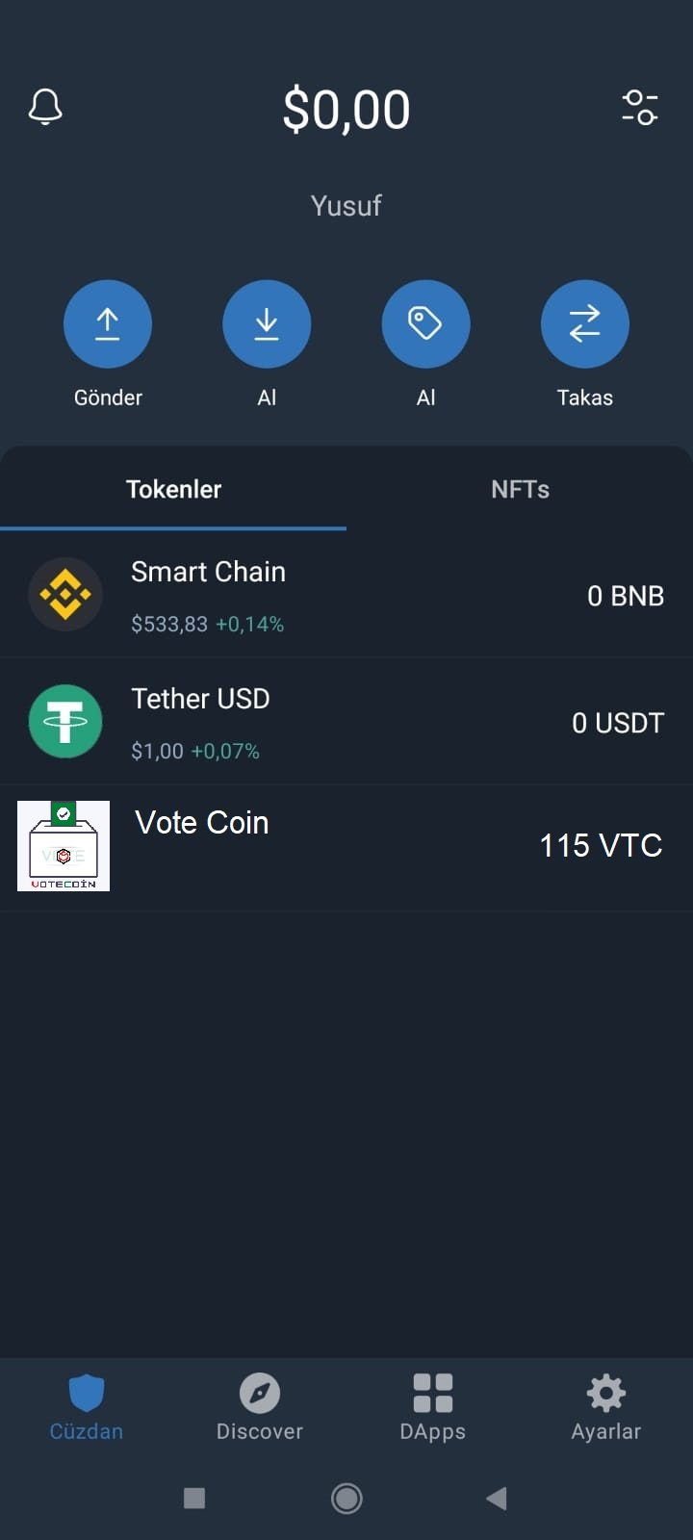
SETUP
The voter can see the VoteCoins obtained from the e-government system in her wallet.
VoteCoins obtained from the system cannot be transferred to another voter wallet.
Unused VoteCoins are sent to the burning address automatically after a certain period of time when the election is over.
In addition, the voters are provided with the necessary coins to run the contracts.

Slide 9
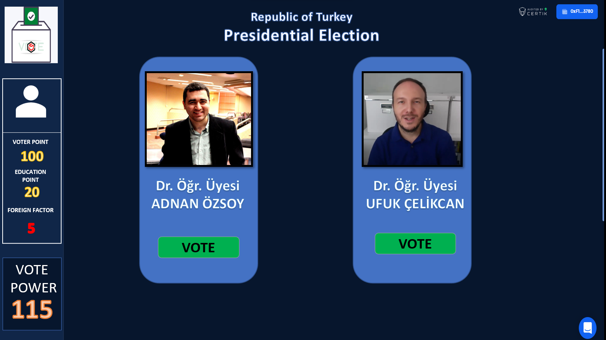
VOTING
The voter links his/her wallet to the election application.
The voter can see the attributes of the VoteCoins they have in detail.
If more than one election will be made at the same time in the same application, the amount of VoteCoins sent to the voter will increase proportionally.
The Voter has the same amount of Vote Power for each different election.

Slide 10

COUNTING OF VOTES
The votes are confirmed and encrypted on the chain through the nodes of the supervisory institutions and political parties in the network.
 | ADNAN ÖZSOY | UFUK ÇELİKCAN
Block 1 | 4300 | 2400
Block N | 3700 | 4400
Total | 8000 | 6800
ELECTION RESULTS
During the counting of the votes, the encrypted votes in the chain are transparently deciphered and counted.
At this stage, voters can check whether their votes have been counted.

Slide 11
ANNOUNCEMENT OF RESULTS
UFUK ÇELİKCAN
ADNAN ÖZSOY
Education Votes
Education Votes
50%
50%
Foreign Nationals Votes
Foreign Nationals Votes
75%
75%
Total Votes
Total Votes
75%
75%
It is not possible to observe the election results until the voting process is over.
Thanks to the qualifications of VoteCoins, an association can be made about the education status of the voters and the country they live in.

Slide 12
Conclusion
Blockchain technology can bring a new way of reliable and transparent voting.
Thanks to the blockchain, e-voting system can enter our lives.
With e-voting system, people who cannot reach the polls on election day will also have the chance to vote from wherever they are.
With blockchain model, all voters are guaranteed to one vote with. The information of the voters who voted is recorded in the blockchain network. In Blockchain technology, it is not possible to change or delete the information recorded on the network. Therefore, each voter can only cast one vote.

Slide 13


In this voting model, no one cannot vote in place of another voter. Each voter can only create a single wallet with his own T.C. identity number through the E-Government system. In this way, it was prevented that someone else would vote instead of the voter. This system can be made more secure by using facial recognition, fingerprint, biometric data.
Thanks to blockchain, counting of votes is open and transparent. In the blockchain model, voting information is stored on the network and anyone with access to the network can read the information on the blockchain. So everyone can verify the accuracy of the vote count.
Exchange on ballots is not possible in blockchain technology. So that no one can interfere with the results

Slide 14

No one can follow the election results until the election time is over. The fact that anyone with access to the blockchain network can read the data on the chain may have some undesirable consequences during the election. For example, estimating the election results before the end of the election may mislead the voters. To avoid this, votes can be encrypted with a key.
In this system, since a copy of the votes, namely the block, is on each node, recounting can be done easily.
Thanks to VoteCoin, the voter's contribution to the election can be determined by evaluating their education, country of residence, etc. socio-economic status.

Slide 15
THANKS !
PELİN FİLDİŞ
P
21827412
C
Coşkun Yusuf ÇETİN
21791709
İHSAN ÇAĞATAY ERASLAN
İ
21827335

